Slide 1
DATA SCIENCE Video Games
Presented by:
Eden Ben Meshi
Nittai Ben Shimol

Slide 2
DATA SCIENCE PROJECT
In this project we will investigate past data of video games for different platforms, and based on data like type of platform, game characteristics, manufacturer, release date, and amount of sales per game, we will see the direct relationship between these variables and the number of sales per game and so it was predicted whether the game would achieve sales of a million units or more? If so, we will define the game as "successful"! As part of the research, we will get information about manufacturers with the largest amount of successful games, the most common platform according to the game genre, the most common platform every year, and more…

Slide 3
OUR PROCESS
Research question
Data handling
Scraping
Conclusion
Defining the research question
Handling missing duplications and outliers data
Predict hit games
Machine Learning
EDA
Extracting data from the Internet
Exploratory Data Analysis advanced data Analysis

Slide 4
01
Research question

Slide 5
THE RESEARCH QUESTION
Success
Fail
We chose a topic that we like games and marketing We investigated whether it is possible to predict the success of a game only based on initial data such as genre, manufacturer, developer, year and month of game release, and more.
This forecast is important for companies and game makers to adopt the new products they develop according to the market

Slide 6
Scraping
02

Slide 7
The structure of the information
Rows:
Each row represents a game
Cloumns:
Game
Pos
Genre
Console
Publisher
Developer
VGChartz Score
Critic Score
User Score
Total Shipped
Total Sales
NA Sales
PAL Sales
Japan Sales
Other Sales
Release Date
Last Update

Slide 8
How we implemented this:
We learned the URL structure of the site.
We concluded that it is best to extract the information from the site by genre.
We have displayed the maximum amount of information on the page to save time in the data extraction process.
We calculated the number of pages available for each genre by dividing the number of “Total results” by the number of results that displayed on each page.
We have created a list of all existing genres.
We went through a loop on all the genres and an internal loop on all the existing pages for the same genre.
On each page, we will import all the table data.
We have put all the information in a list that corresponds to it.
When done, we created a data frame from all the lists and exported it to Excel files.

Slide 9
61326 × 17
This is the amount of the information that we extracted from the site:
https://www.vgchartz.com

Slide 10
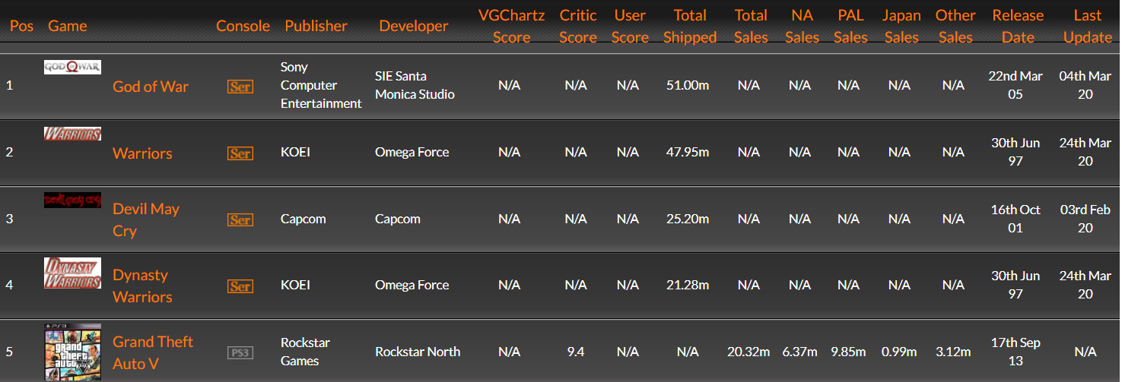
The results
This is how the information looks on the site

Slide 11
The results
This is how the information looks in the Excel file we created
 | Game | Pos | Genre | Console | Publisher | Developer | VGChartz Score | Critic Score | User Score | Total Shipped | Total Sales | NA Sales | PAL Sales | Japan Sales | Other_Sales | Release_Date | Last_Update
0 | God of War | 1 | Action | Series | Sony Computer Entertainment | SIE Santa Monica Studio | N/A | N/A | N/A | 51.00m | N/A | N/A | N/A | N/A | N/A | 22nd Mar 05 | 04th Mar 20
1 | Warriors | 2 | Action | Series | KOEI | Omega Force | N/A | N/A | N/A | 47.82m | N/A | N/A | N/A | N/A | N/A | 30th Jun 97 | 24th Mar 20
2 | Devil May Cry | 3 | Action | Series | Capcom | Capcom | N/A | N/A | N/A | 25.20m | N/A | N/A | N/A | N/A | N/A | 16th Oct 01 | 03rd Feb 20
3 | Dynasty Warriors | 4 | Action | Series | KOEI | Omega Force | N/A | N/A | N/A | 21.15m | N/A | N/A | N/A | N/A | N/A | 30th Jun 97 | 24th Mar 20
4 | Frogger | 5 | Action | Series | Konami | Konami | N/A | N/A | N/A | 20.00m | N/A | N/A | N/A | N/A | N/A | 23rd Oct 81 | 26th Feb 20
5 | God of War (2018) Read the review | 6 | Action | PC | Sony Interactive Entertainment | SIE Santa Monica Studio | 9.0 | 9.7 | 10.0 | 19.50m | N/A | N/A | N/A | N/A | N/A | 20th Apr 18 | 15th Feb 22

Slide 12
03
Data handling

Slide 13
Handling missing data:
We removed rows with missing information from the following categories:
“Play”
“Console”
“Developer”
“Total sales” as well as “Total shipped” (only if the information was missing in both categories) We then merged the columns into one column with the "Total Sales" category
“Release date” and “Last update” date (only if the information was missing in both categories) We then merged the columns into one column with the "Release Date" category

Slide 14
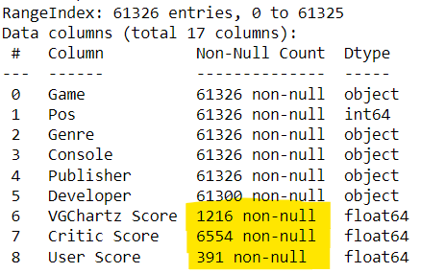
Handling missing data:
We deleted the following columns:
'VGChartz Score','Critic Score','User Score'
because we found that there was too much missing information, as can be seen in the following image:

Slide 15
Handling duplicates:
We have seen that there are 5160 duplicates in both the "game" and "console" categories, to handle this duplication we used a help column that contains the amount of missing information in each row, and so we removed the rows that contained the least information and kept the row with the least missing information.

Slide 16
Editing data:
We had to change the information displayed as a string in the columns of the sales quantity to a decimal number for example:
"51.00m" to 51,000,000
We extracted from the string of the game release date to specific columns of "Release Year" and "Release Month" for example:
"30th Jun 97" to "Year of Release" - 1997 and "Month of Release" - 6
We added a "hit games" column and entered ‘1’ when the sales volume of that game was over ‘1’ million and ‘0’ otherwise
We deleted all games released before 1980 because we defined them as outliers for our research

Slide 17
17487 × 14
This is the amount of information after we have edited the rescue we extracted from the site

Slide 18
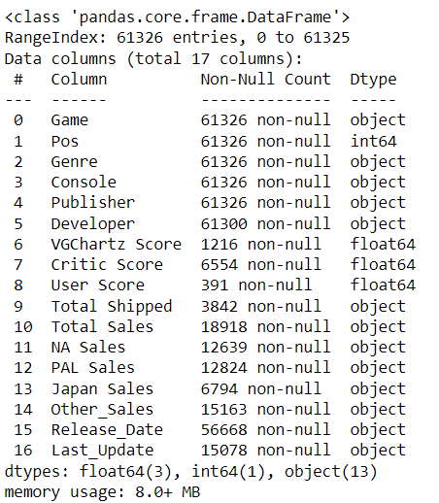
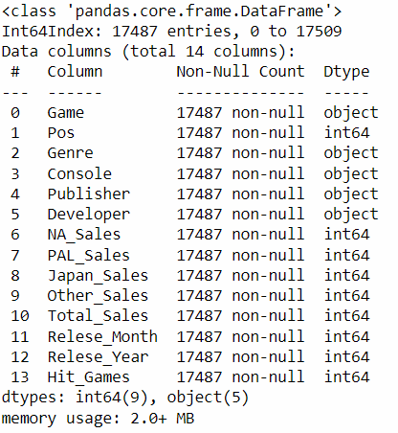
BEFORE AFTER

Slide 19
EDA
04

Slide 20
Dataset
Game — The games name
Console — Platform of the games release (i.e. PC, PS4, etc.)
Genre — Genre of the game
Publisher — Publisher of the game
Developer — Developer of the game
NA_Sales — Sales in North America (in millions)
PAL_Sales — Sales in Europe (in millions)
Japan_Sales — Sales in Japan (in millions)
Other_Sales — Sales in the rest of the world (in millions)
Total_Sales — Total worldwide sales
Hit_Games - hit game(1) or not(0)

Slide 21
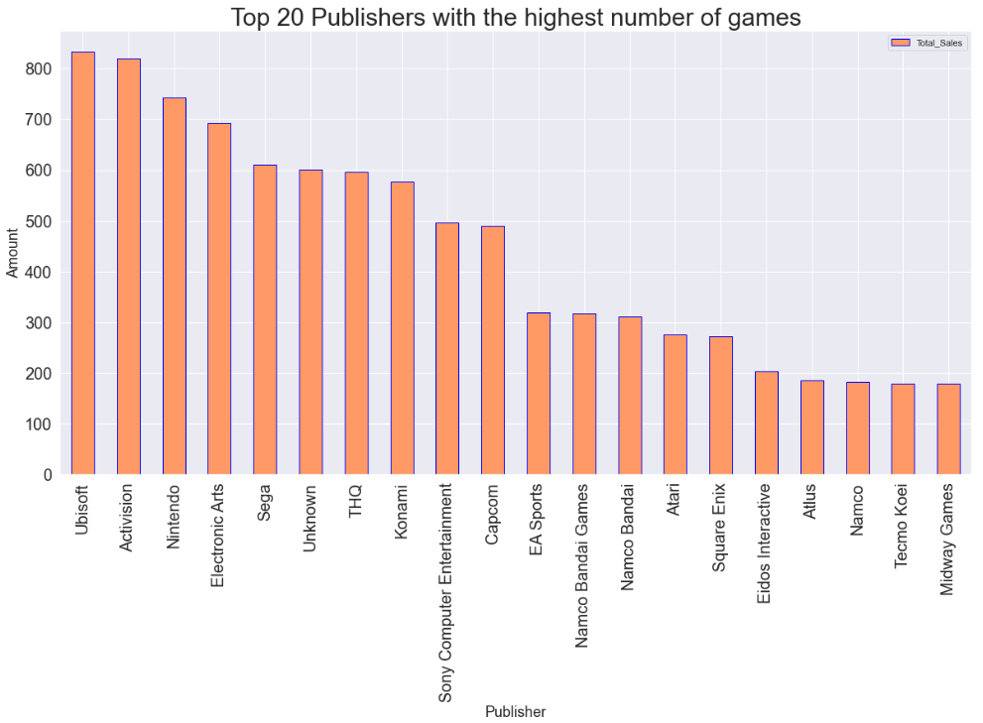
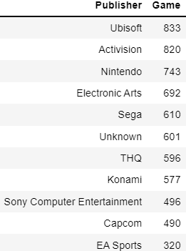
The leading Publishers are Ubisoft Activision & Nintendo
Univariate Analysis

Slide 22
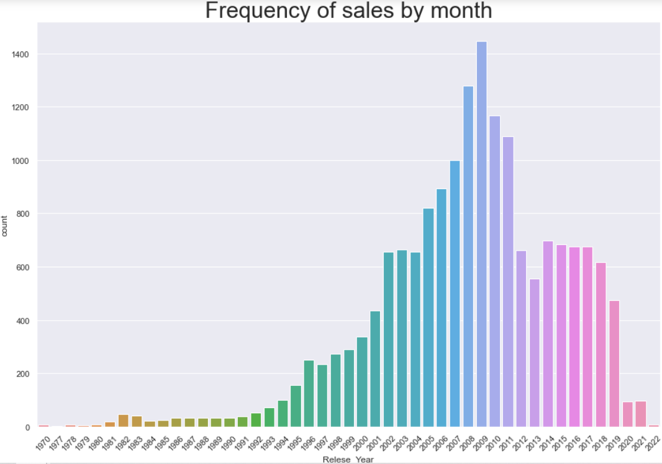
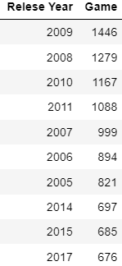
Univariate Analysis
The years with the highest game releases are between 2008-2010

Slide 23
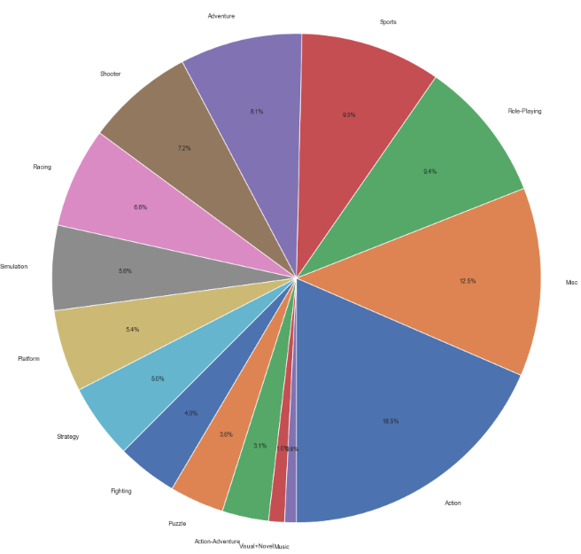
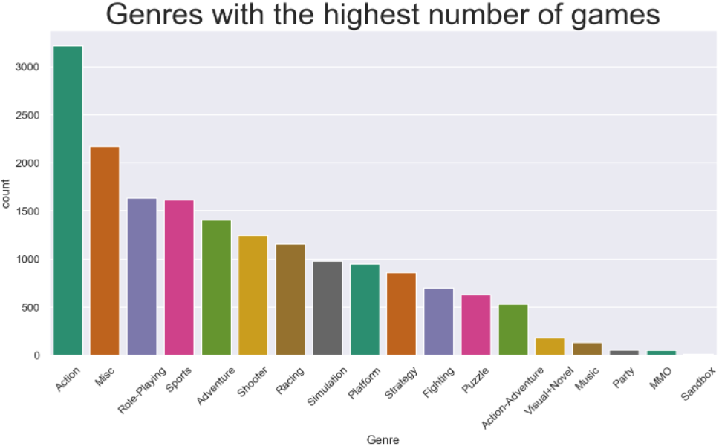
Univariate Analysis
Games belonging to “Action” genre are leaders in the number of games per genre, they control almost 20 percent of the video games market share and they are popular more than any other genre

Slide 24
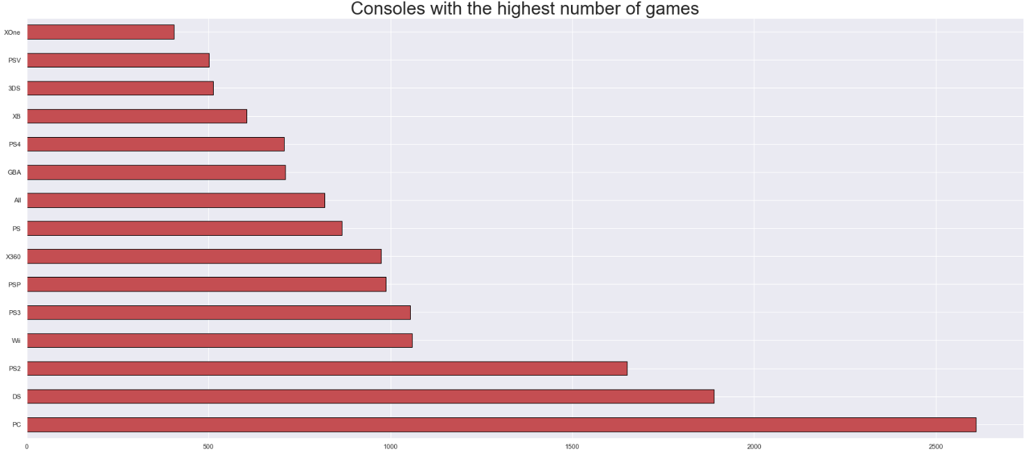
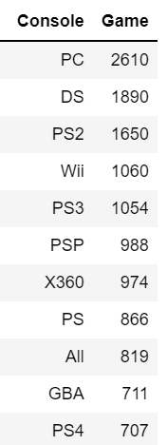
The consoles with the most games are PC Nintendo DS & PS2
Univariate Analysis

Slide 25
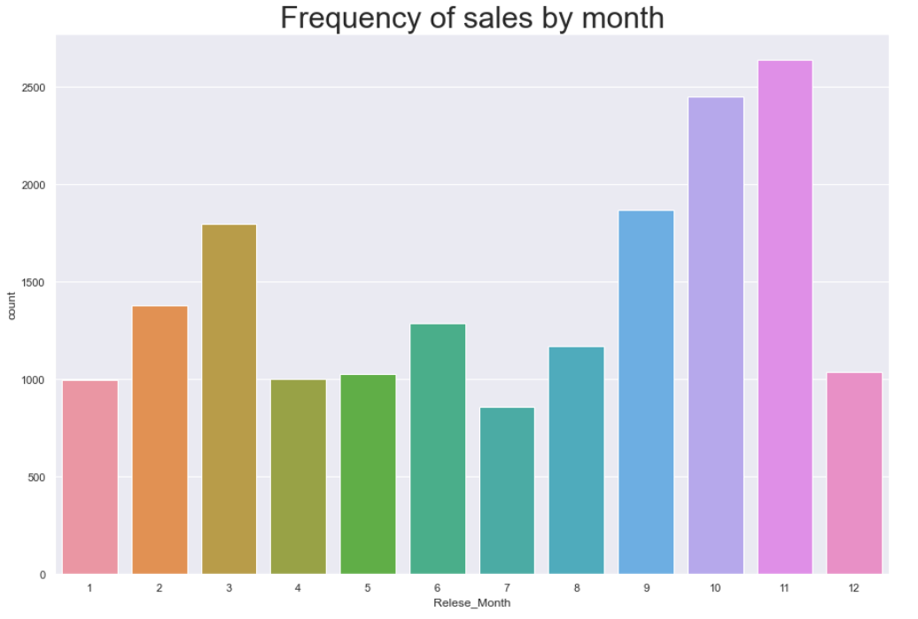
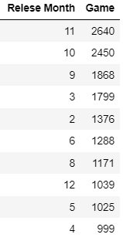
The months with the highest game releases are November & October
Univariate Analysis

Slide 26
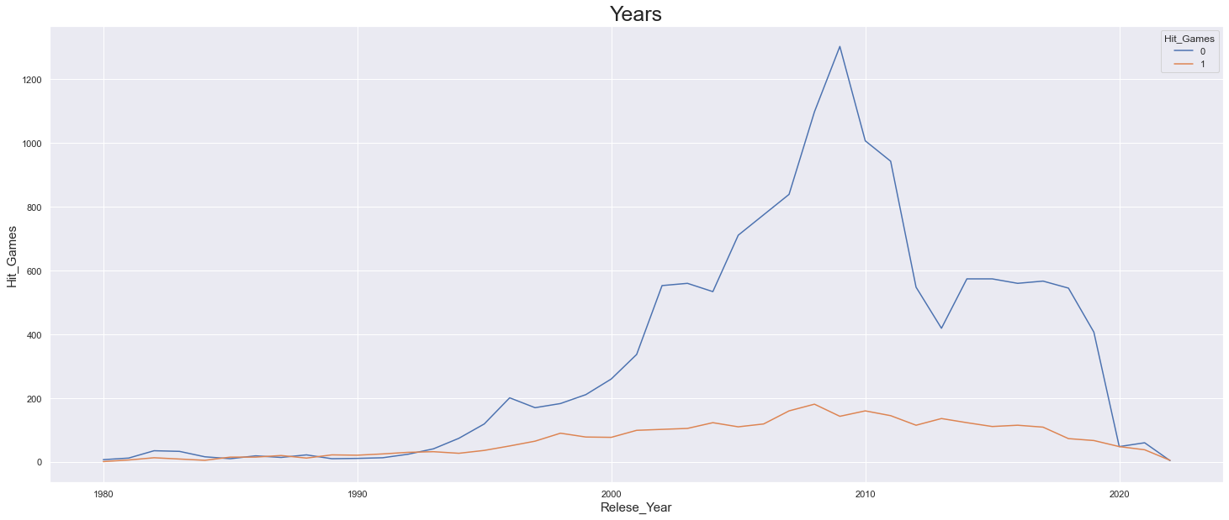
Years – Hit Games Since the 1990s average sales have been reduced due to increase in games releases every year, And this is the main reason why game chances to be a Hits games have decreased
Bivariate Analysis

Slide 27
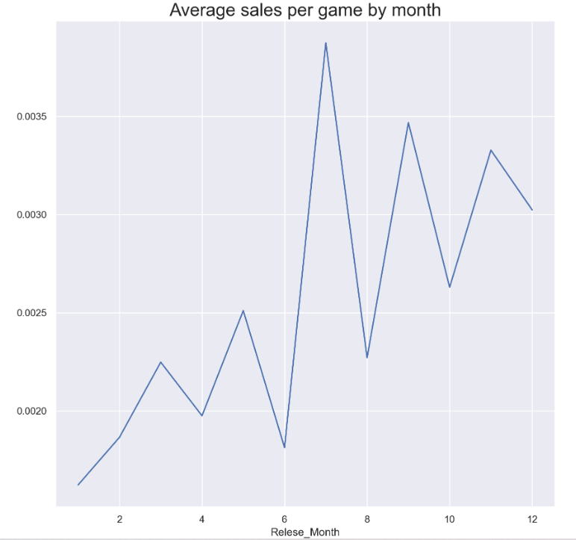
The popular month to purchase games is July July is the month that all high school students go on vacation, this reason explains the fact that July is the popular month to purchase games
Bivariate Analysis

Slide 28
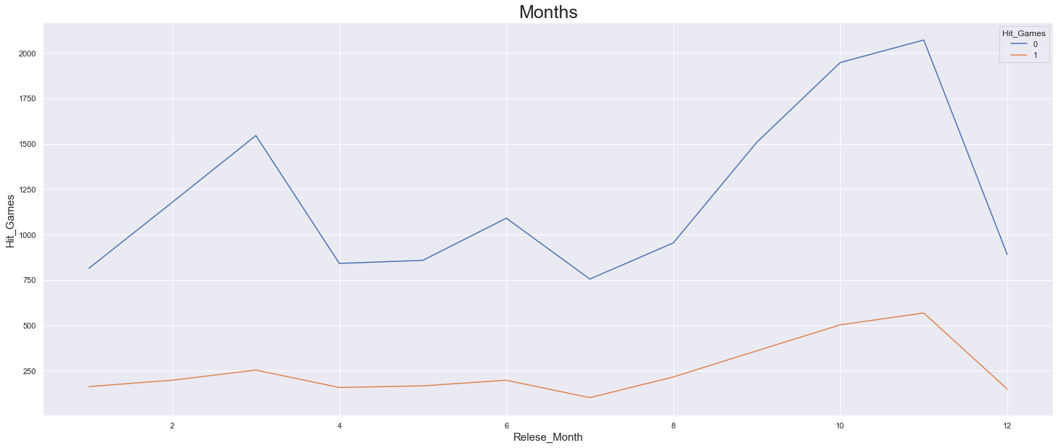
Months – Hit Games The months with the most game released are October and November due to the beginning of winter, It also explains why they are the months with the most Non-Hits
Bivariate Analysis

Slide 29
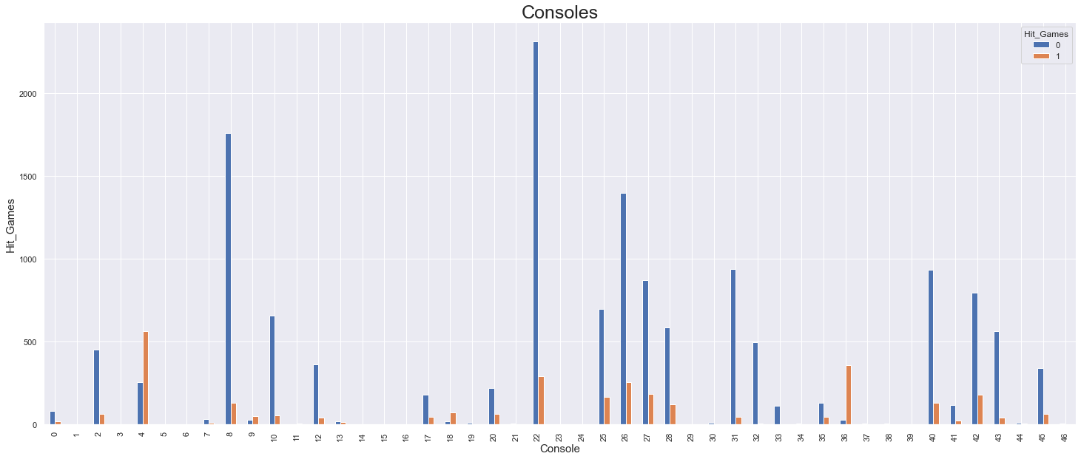
Consoles – Hit Games The ‘PC’ is the platform with the most games releases – around 2600 games, It also explains why it is the platform with the most non-hits
Bivariate Analysis

Slide 30
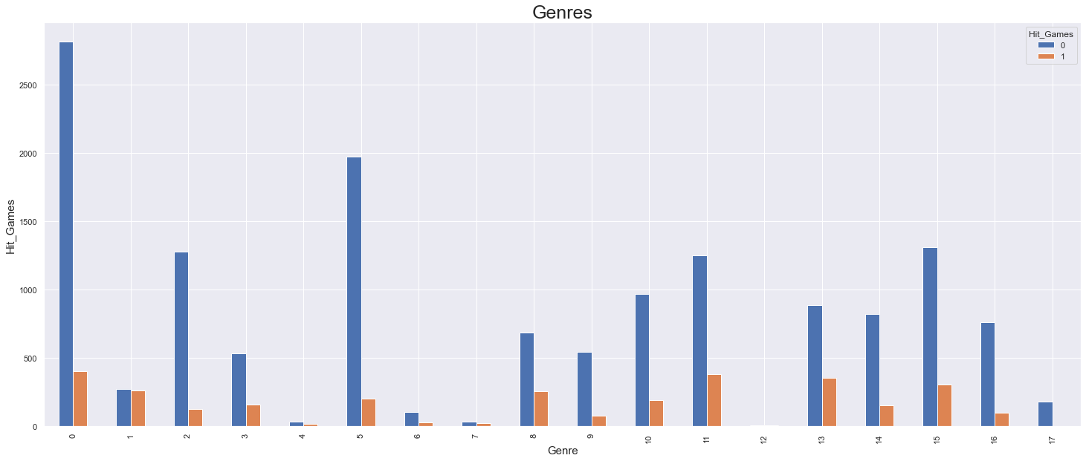
Genres – Hit Games The most popular genre is 'Action' with about 3200 released games, this also explains why it is the game with the most Non-Hits
Bivariate Analysis

Slide 31
Since the 1990s average sales have been reduced due to increase in games releases every year, And this is the main reason why game chances to be a Hits games have decreased
Bivariate Analysis

Slide 32
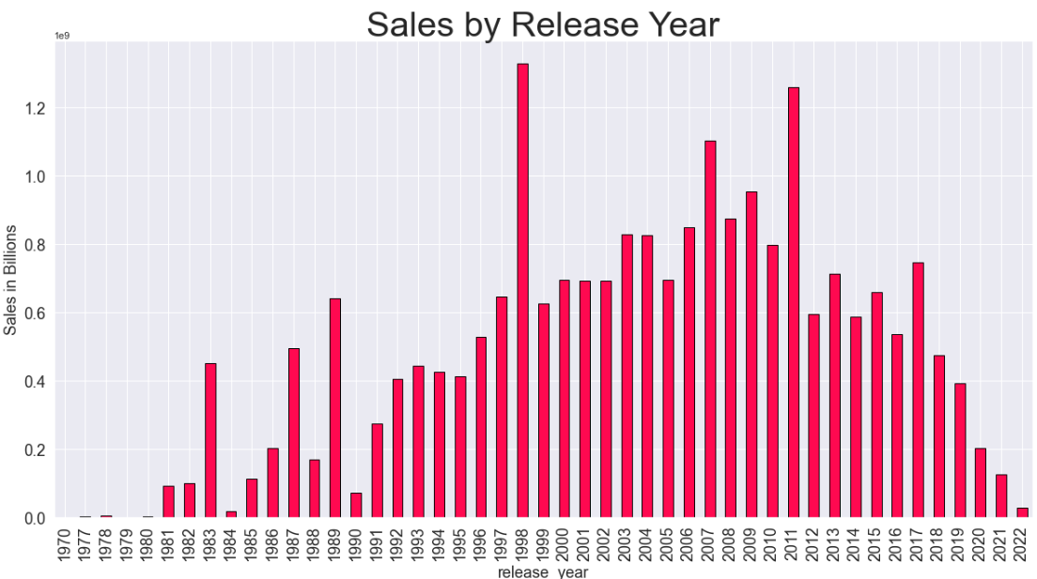
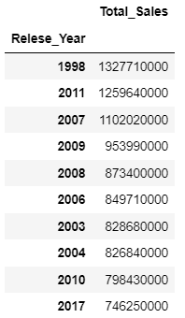
Bivariate Analysis

Slide 33
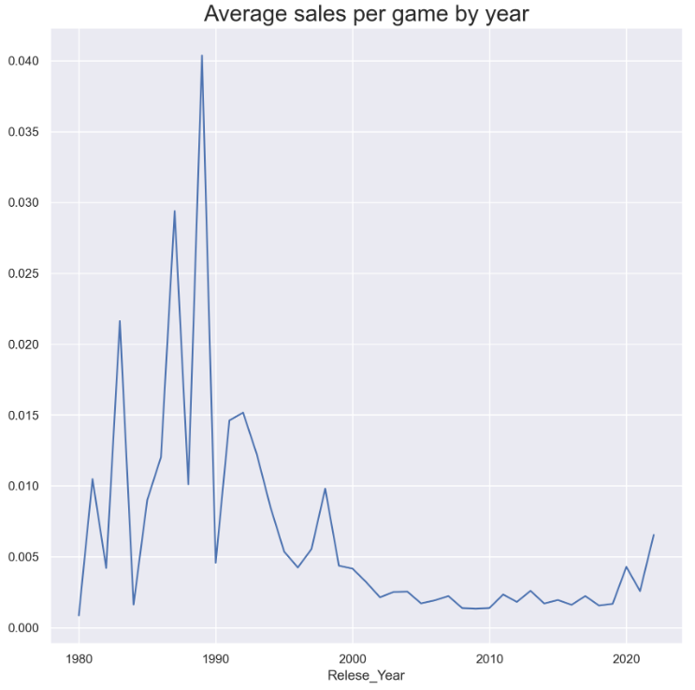
The year with most games received the highest average purchases is 1989
Bivariate Analysis
It can be inferred from the graph that when a game was a hit until the 90s,
his average purchases were higher than today due to the large number of game releases today

Slide 34
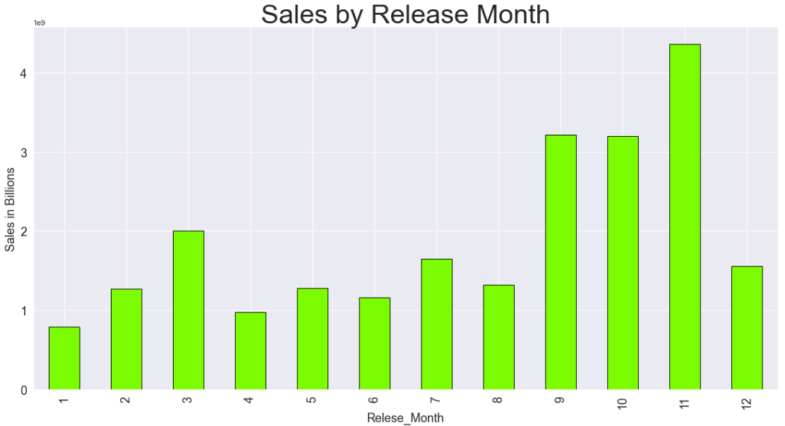
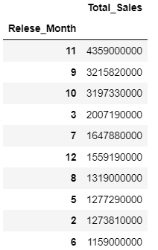
Bivariate Analysis
The years with the the most sales are November, September & October

Slide 35
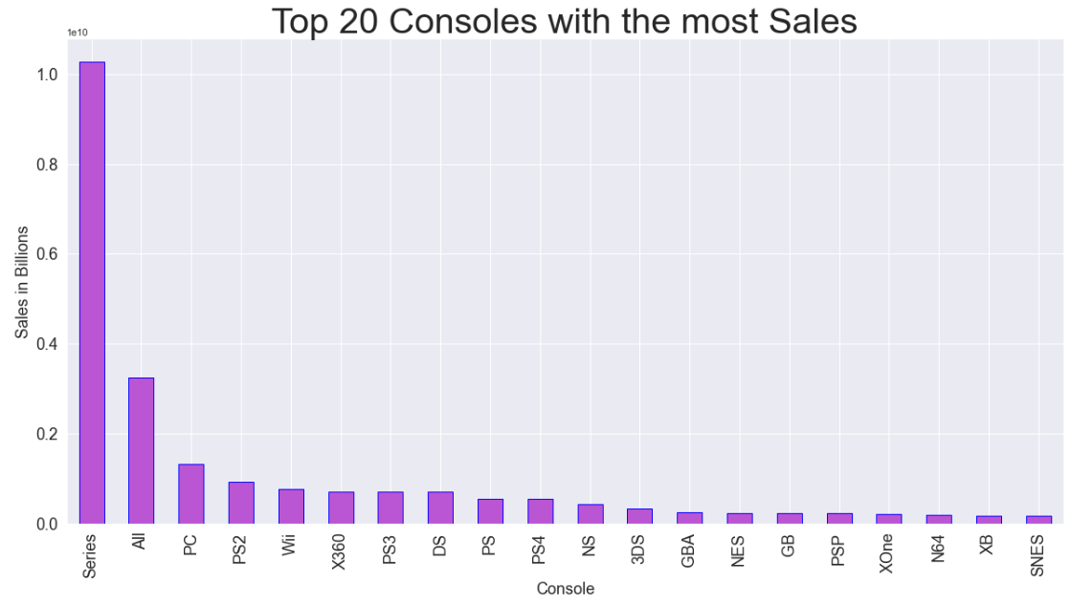
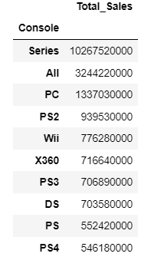
Bivariate Analysis
The Consoles with the most sales are Xbox Series X & PC

Slide 36
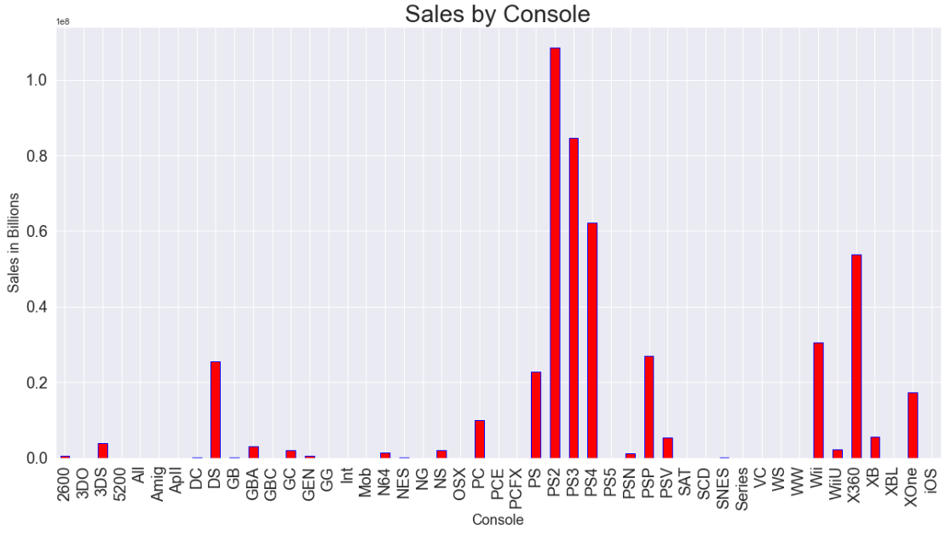
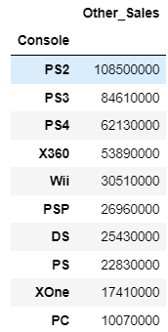
Bivariate Analysis
The Consoles with the most sales Unrelated to sales in NA, Europe or Japan are Xbox Series X & PC

Slide 37
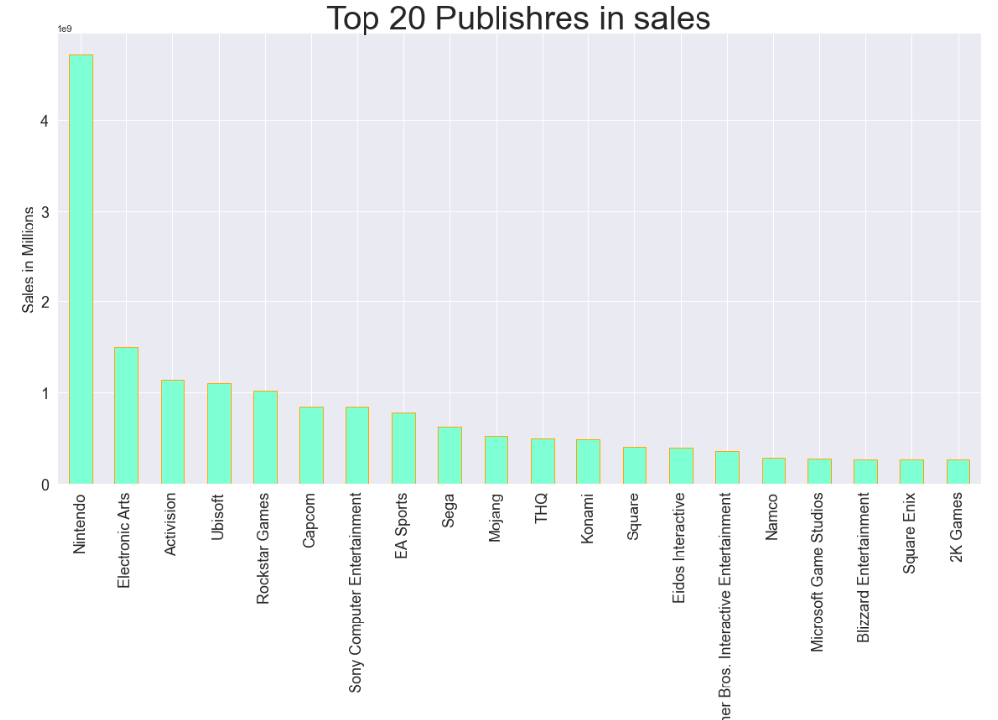
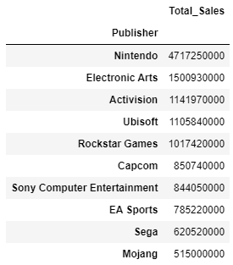
Bivariate Analysis
The Publishers with the most sales are Nintendo & Electronic Arts

Slide 38
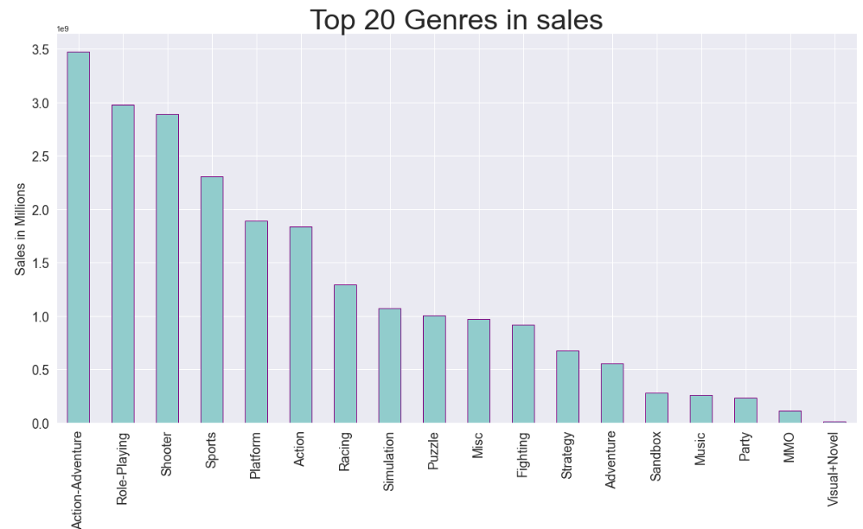
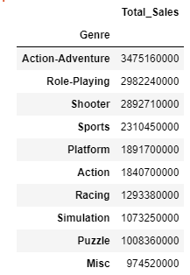
Bivariate Analysis
The Genres with the most sales are Action-Adventure & Role-Playing

Slide 39
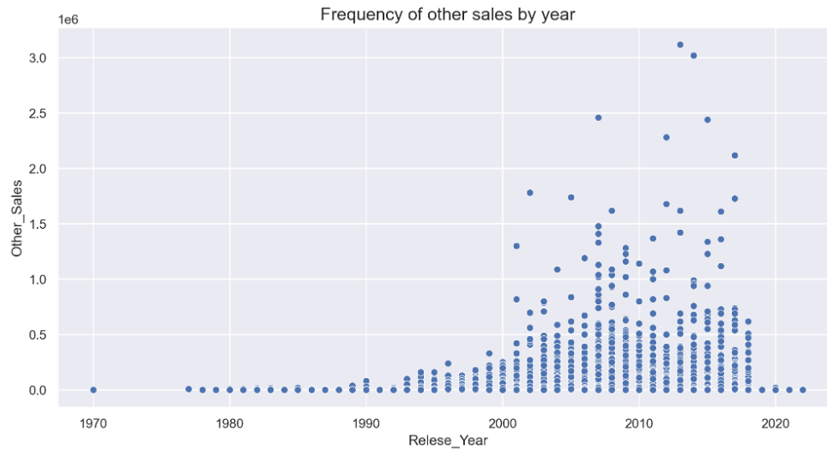
Bivariate Analysis
From the following scatterplot, we can see that most game belonging to 'other sales' made global sales of below roughly $1 million sales, with some exceptionally good ones going beyond that.

Slide 40
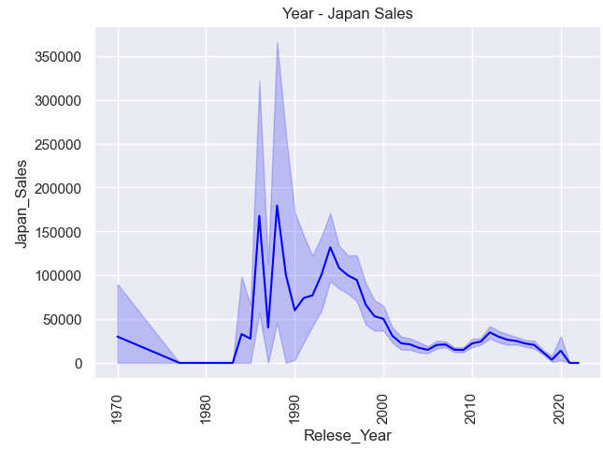
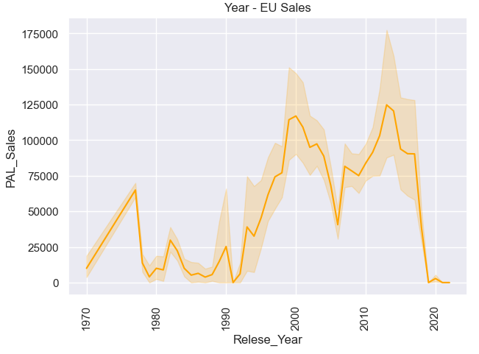
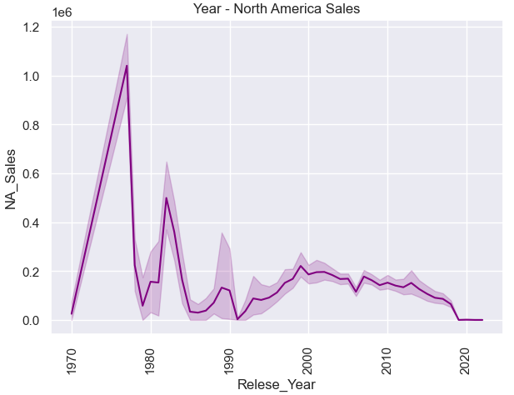
Bivariate Analysis
Plots that Showing the distribution of sales by region
Sales in Europe peaked in the 2000s and on, while other regions peaked before the 2000s.

Slide 41
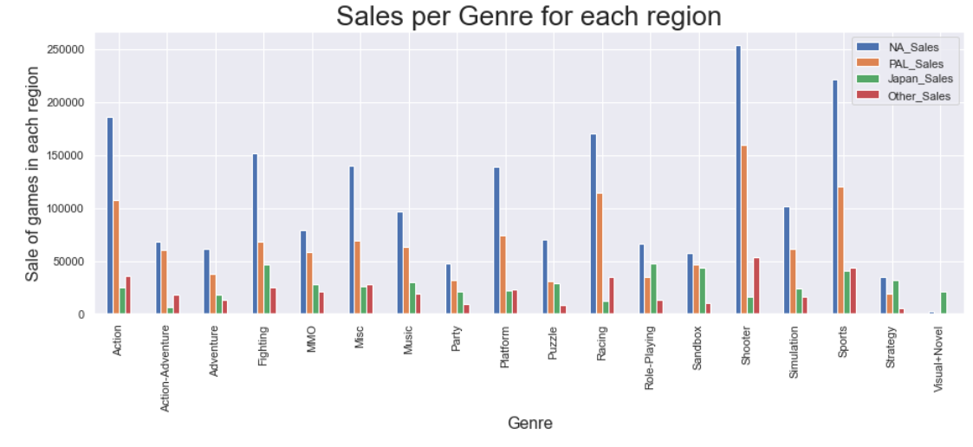
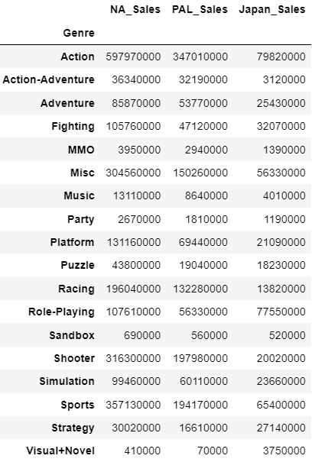
Multivariate Analysis
Genre with the highest total sales volume in each region

Slide 42
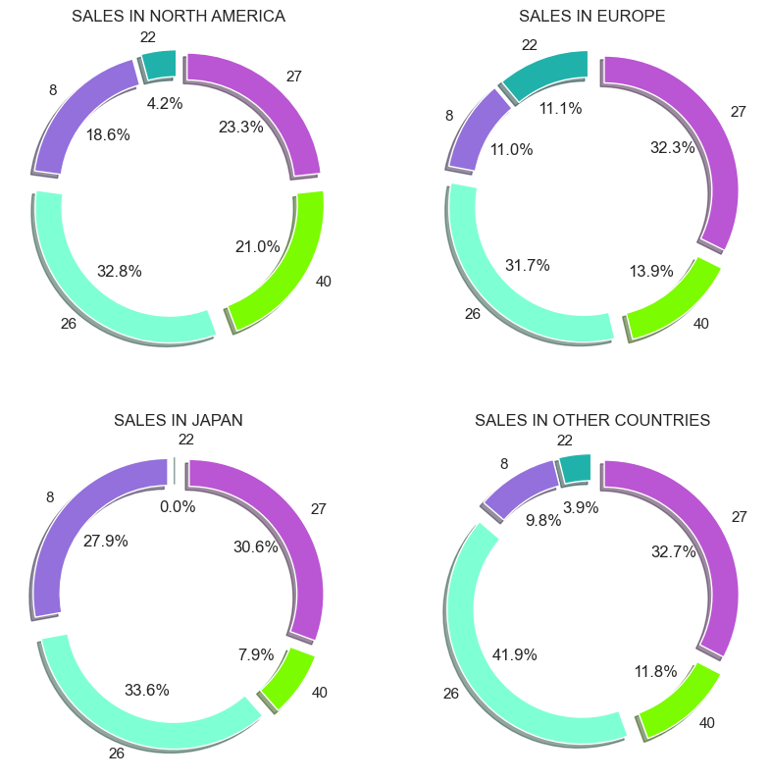
Multivariate Analysis
Distribution with percentages of the top 5 consoles by region

Slide 43
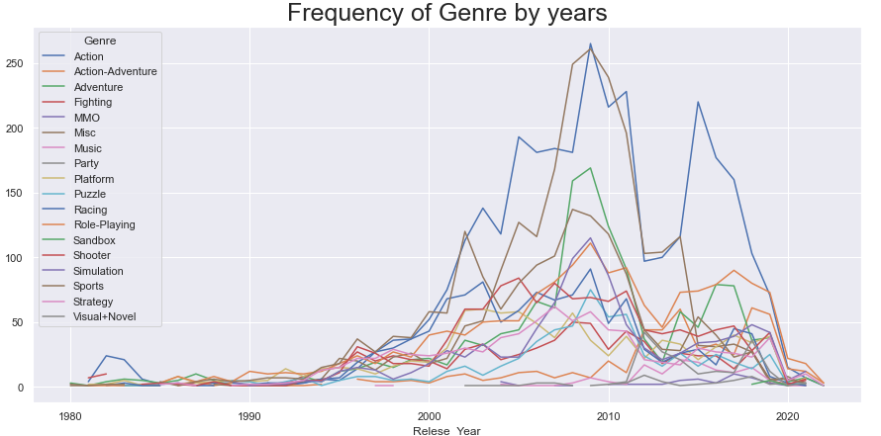
Multivariate Analysis
Games amount of each particular genre by year

Slide 44
Multivariate Analysis
Genre with the highest total sales volume in each region

Slide 45
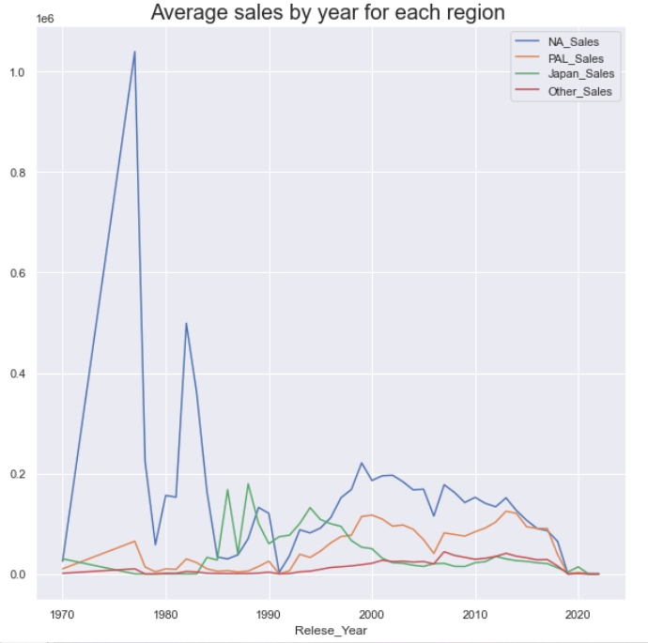
Multivariate Analysis
Grouping sales data of each region yearly and plotting the same

Slide 46
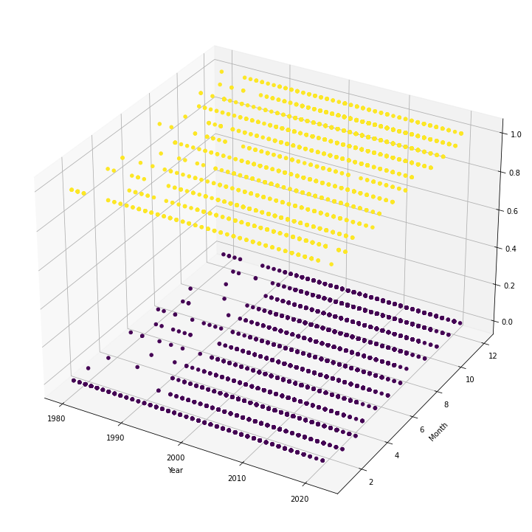
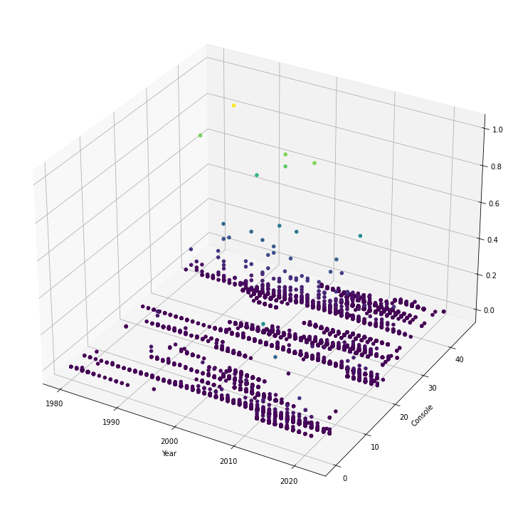
Multivariate Analysis
Hit games
Month
Year
Total Sales
Console
Year

Slide 47
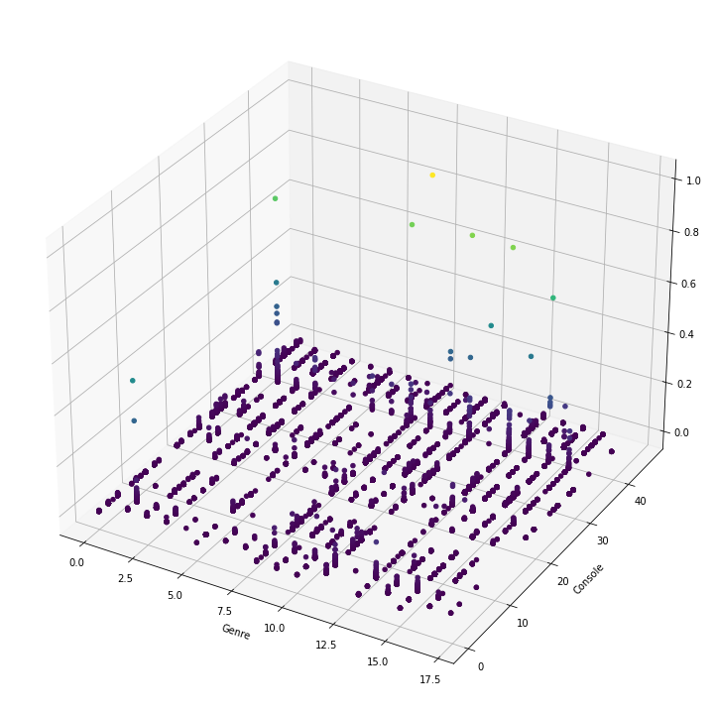
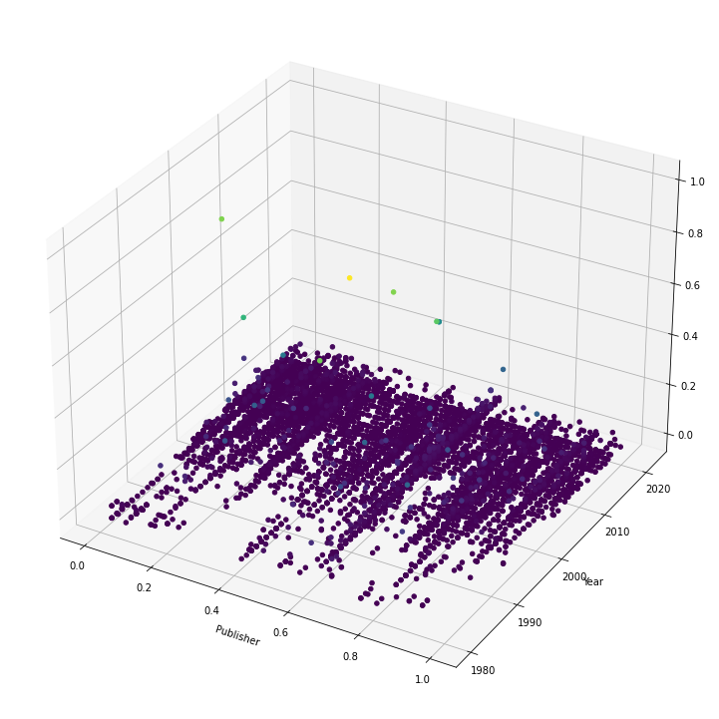
Multivariate Analysis
Total Sales
Console
Genre
Total Sales
Year
Publisher

Slide 48
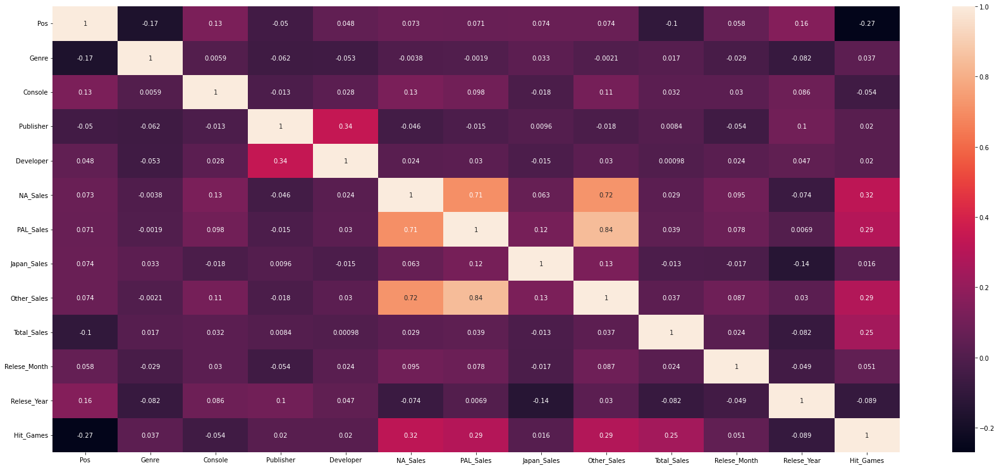
Multivariate Analysis

Slide 49
Inferences Based on our analysis, we can inferred the following conclusions: *PS Platform, published in 1994, made the most sales worldwide. This is echoed by both Japan and EU regions. However, it is a different story in NA, with Call of Duty: Black Ops dominating in north america and Grand Theft Auto V in Europe
*50% of top 10 games utilized the PS Platform, making it one of the most successful consoles. This could be because of the fact that the PS system was one of the most innovative consoles of its time.
*Action, Sports and Role-Playing are the most popular genres with high game titles as well as high global sales made Nintendo snatched the spot for the Publisher that made the most global sales. Unsurprising is the fact that the top sales by developer is Nintendo!

Slide 50
Inferences *Sports is one of the leading genres in Japan and Europe, compared to NA which it’s Action & Shooter
*PS2 & PS3 Consoles are the most popular platform in global Sales around the world, Compared to PC with the fewest sales although they are the console with the most game releases

Slide 51
05
Machine Learning

Slide 52
Our machine learning
To run machine learning algorithms on our information, we converted all categories from "string" variables to numeric variables.
We split the information into tables of "x_train", "y_train", "x_test", "y_test" in a ratio of 0.8 for training and 0.2 for testing.
We scaled the data.
We calculated the best k for the KNN algorithm.
We calculated the best maximum depth and the minimum amount of leaves for the best splitting.
We have created a model for each of the following algorithms: "logistic_regression", "naive_bayes", "svm", "knn", "decision_tree"
We trained on the information and tested each algorithm individually and compared results of:
"accuracy", "precision", "recall", "f-measure"
We will present the results in the following slides.

Slide 53
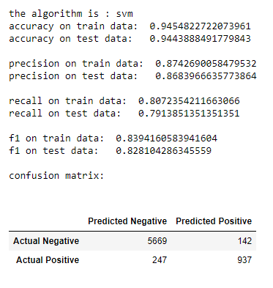
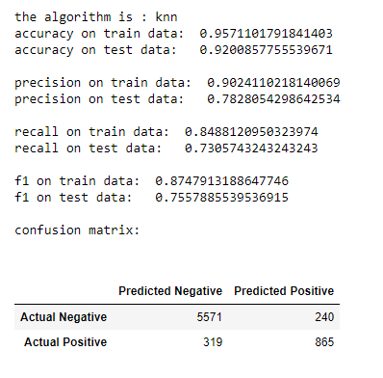
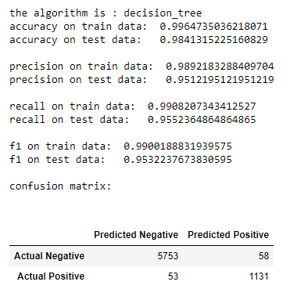
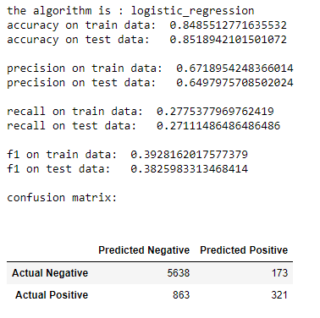

Comparison of results

Slide 54






Slide 55
Our machine learning
We chose the “Decision Tree" algorithm for our project for the following reasons:
Once we have selected the accuracy and coverage levels of each algorithm on its own, it can be seen from the comparison we made that the "decision tree" algorithm gives the best result in choosing the "decision tree" algorithm for our project.
Compared to other algorithms, decision trees require less effort to prepare data during pre-processing and decision tree does not require normalization of the data.

Slide 56
Conclusion
06

Slide 57
Our machine learning
So what we did in the project:
We asked a research question "How can you predict the success of a video game?"
We extracted data from a website that includes all the information provided when a game is first released.
We edited the information, dealt with missing and duplicate information until we reached a desired result.
We presented the relationship between the variables in the table for the purpose of forecasting and machine learning.
We performed machine learning on the information and chose the “Decision tree" algorithm
Along the way we drew interesting conclusions in the field of video games that we will present in the following slides.

Slide 58

Multivariate Analysis
Top 10 Sales per console based on each region

Slide 59

Multivariate Analysis
Top 10 games with the highest sales volume

Slide 60


THANKS
Do you have any questions?
Eden4617@gmail.com nittaibsh@gmail.com
https://github.com/EdenBenMeshi/PredictHitGames

